Slide 1
Care Provider Partnership Agreement Program (CPPAP)
Presented by Dr. Ethelle Lord
Founder, International Caregivers Association
Creator and Developer of the CPPAP

Slide 2
Empowering Businesses to Provide Superior Dementia Care

Slide 3
Chinese Proverb
3 things never come back:
TIME
WORD
OPPORTUNITY
Therefore do not lose time,
choose words,
and do not miss the opportunity.

Slide 4
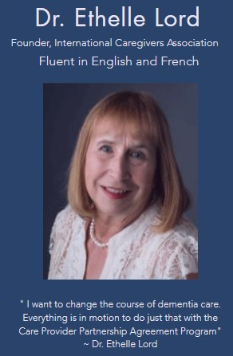

Slide 5
I am a dementia management consultant and the founder of the International Caregivers Association.
I am the creator of the Care Provider Partnership Agreement Program for dementia care business owners. I have a consulting practice in Southern California and in Northern Maine.
Through research, I have discovered the "missing" piece of the puzzle in dementia care that allows management to increase their bottom line by improved employee retention and superior dementia care delivery to their customers.

Slide 8
COMMON PROBLEMS

Slide 13
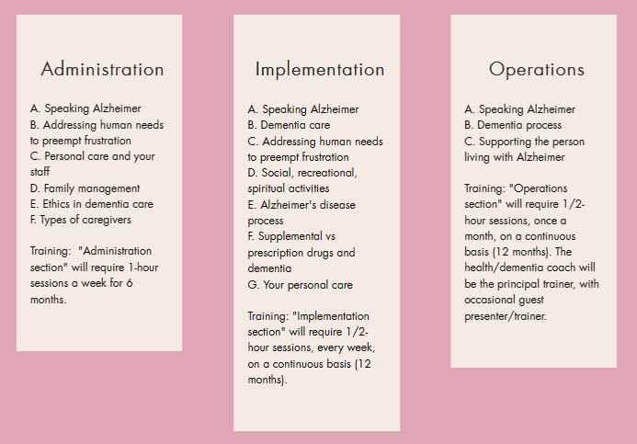
TRAINING OVERVIEW
Training may include a presentation, reading material, videos, group exercises, and other training to include socially and spiritual sensitive material.

Slide 14
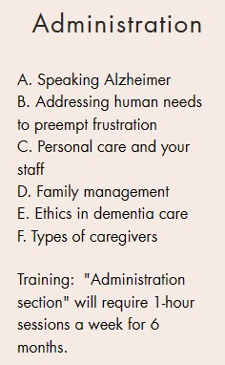

Slide 15
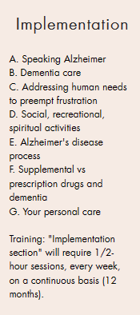

Slide 17
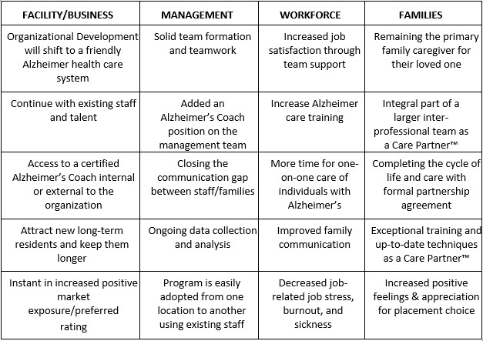
BENEFITS

Slide 19
For additional information, a consultation appointment,
or to request a copy of Dr. Lord’s
White Paper on the Care Provider Partnership Agreement Program
please text or email
Text or call: 207-769-9447
email: lordethelle@gmail.com

